Slide 1
Figures by species
1
Present – seasonal maps, 2 depths
Future 245 – seasonal maps, 2 depths
Future 585 – seasonal maps, 2 depths
Future 245 – decadal and hovmuller
Future 585 – decadal and hovmuller

Slide 2
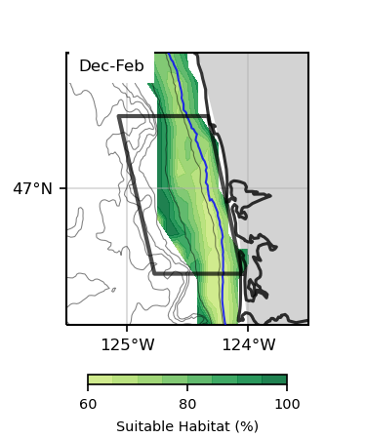
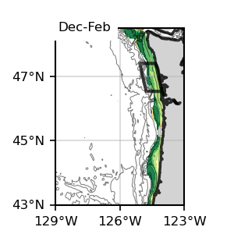
Bottom
1
Bottom
1
Dungeness Crab, Present

Slide 3
Bottom
1
Bottom
1

Slide 4
Dungeness Crab
Bottom

Slide 5
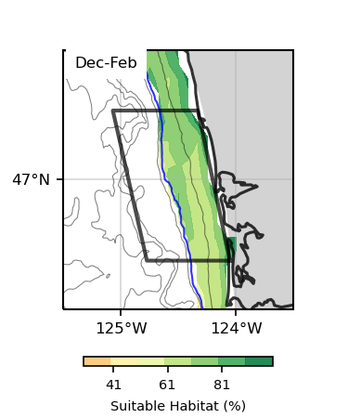
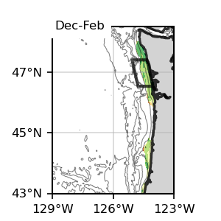
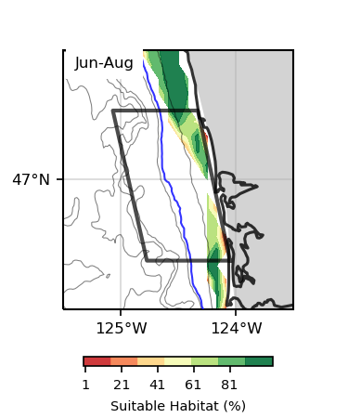
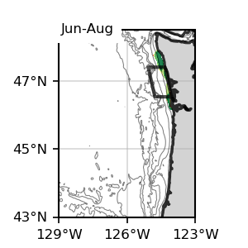
Bottom
1
Bottom
1
Dungeness Crab, Present

Slide 6
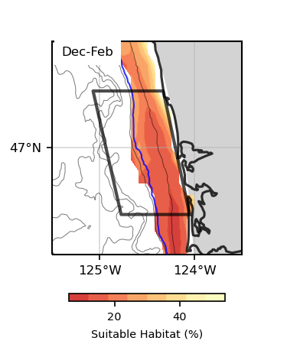
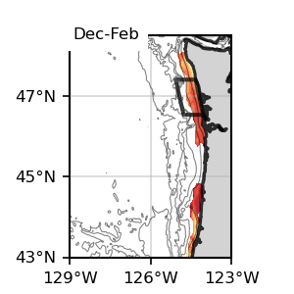
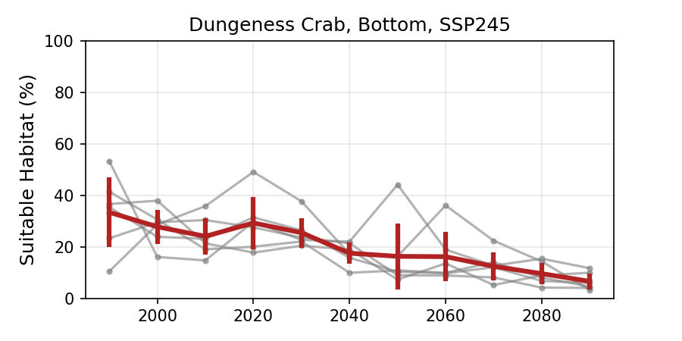
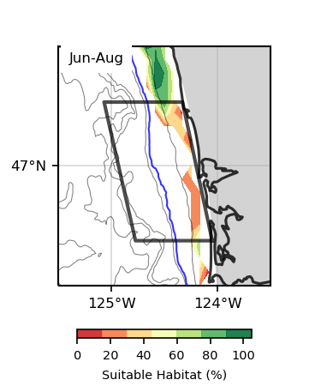
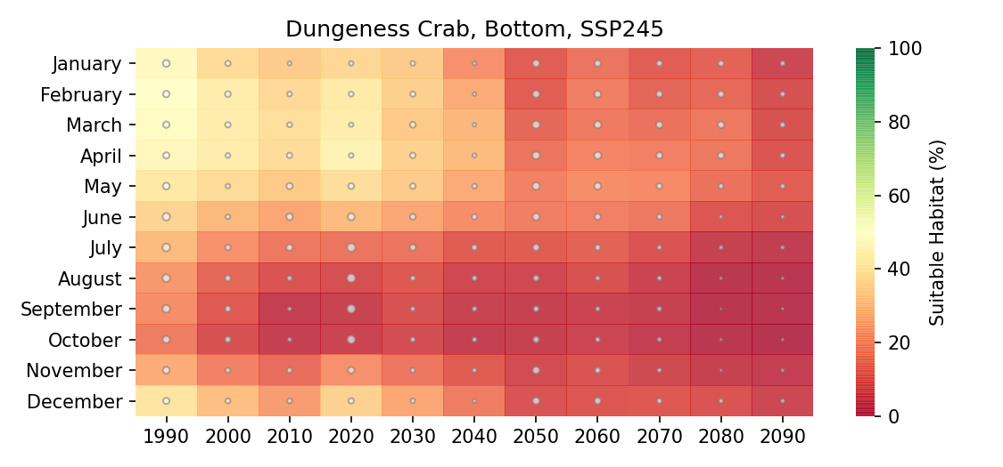
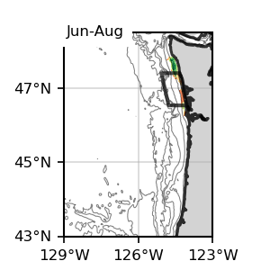
Bottom
1
Bottom
1

Slide 7
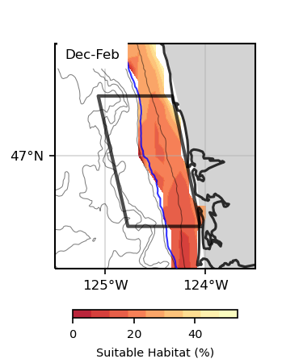
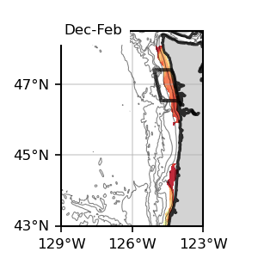
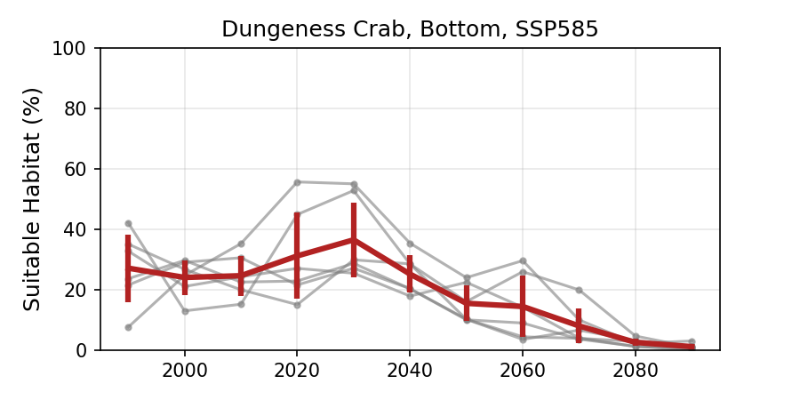
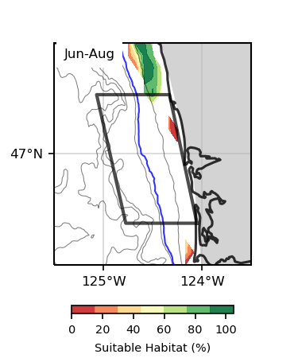
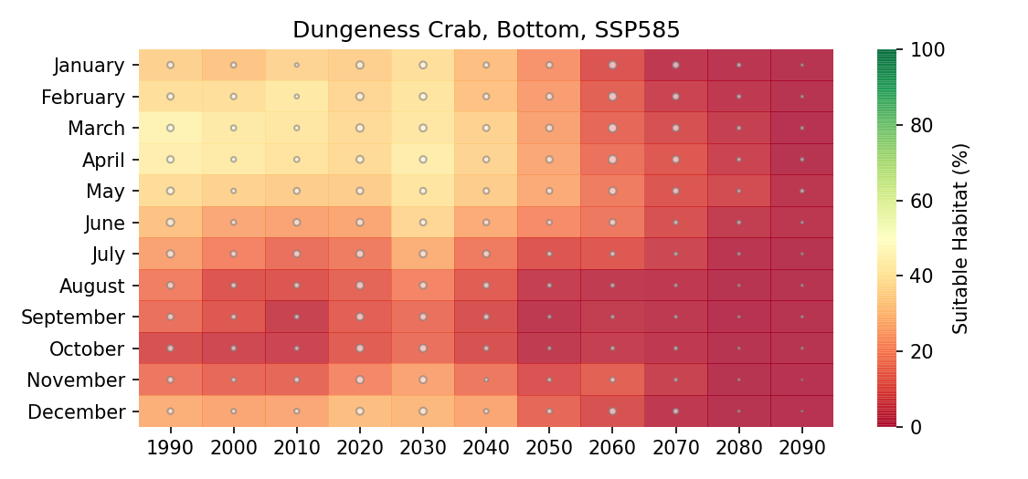
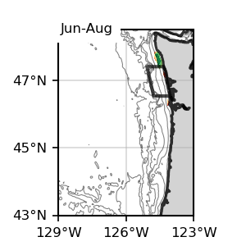
Bottom
1
Bottom
1

Slide 8
Sablefish
Bottom

Slide 9
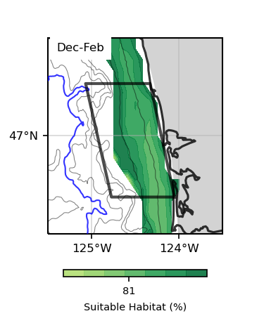
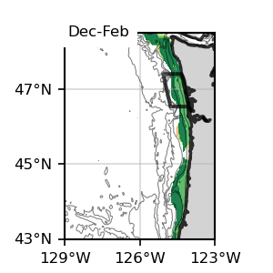
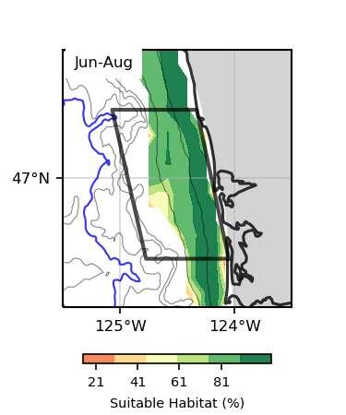
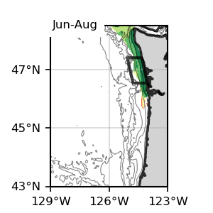
Bottom
1
Bottom
1
Sablefish, Present

Slide 10
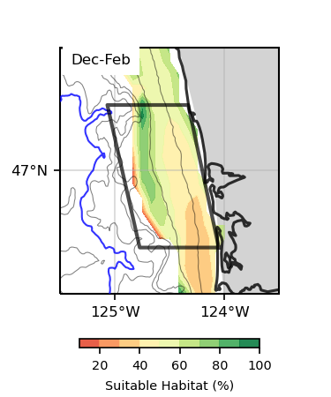
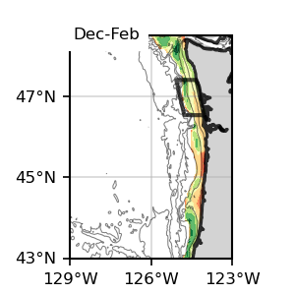
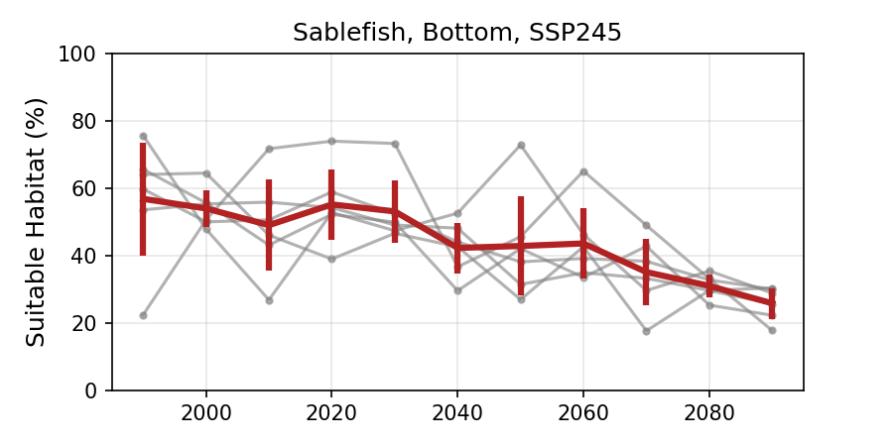
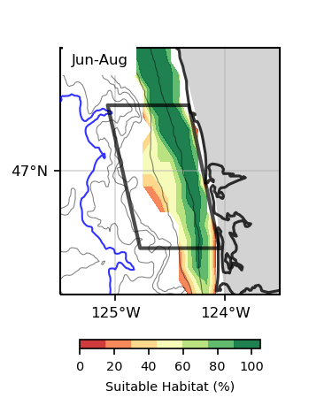
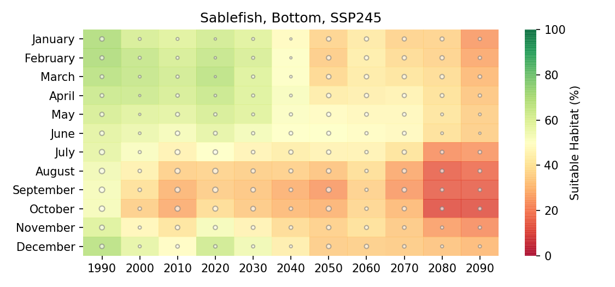
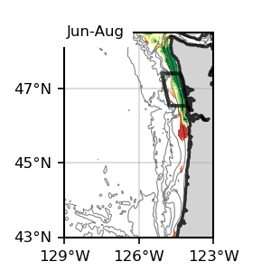
Bottom
1
Bottom
1

Slide 11
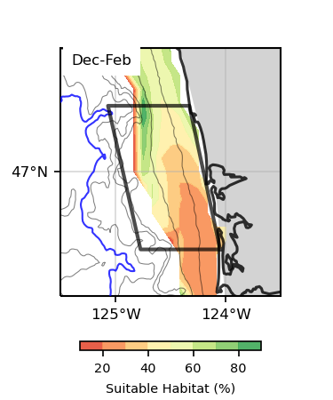
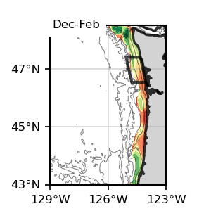
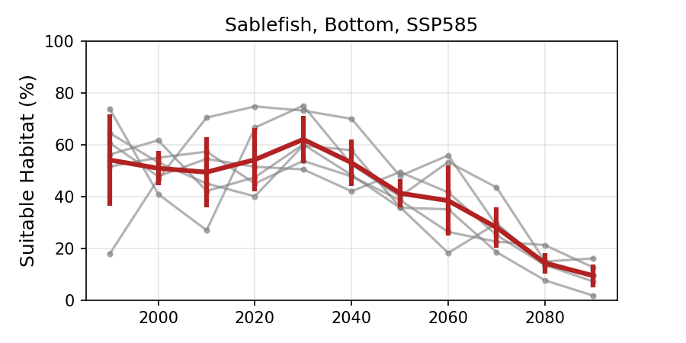
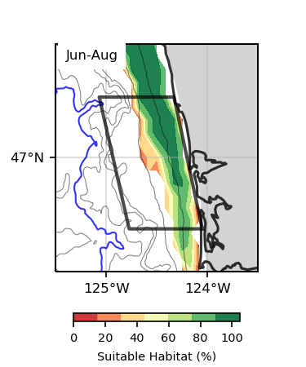
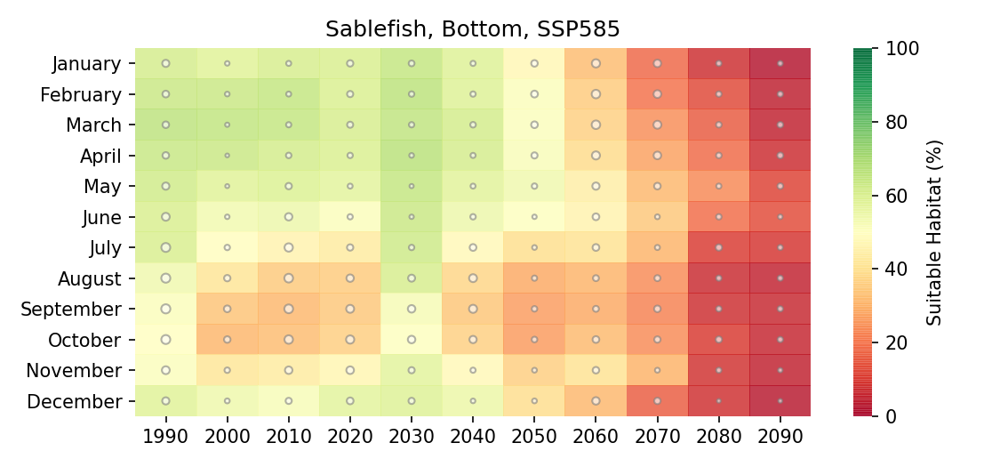
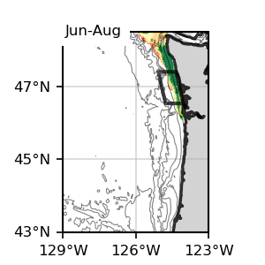
Bottom
1
Bottom
1

Slide 12
Pacific Halibut
Bottom

Slide 13
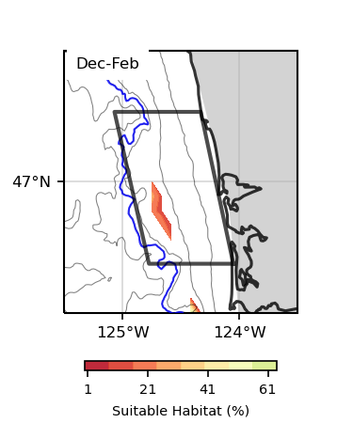
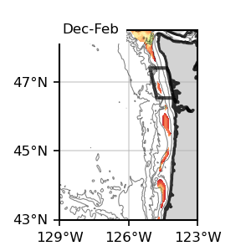
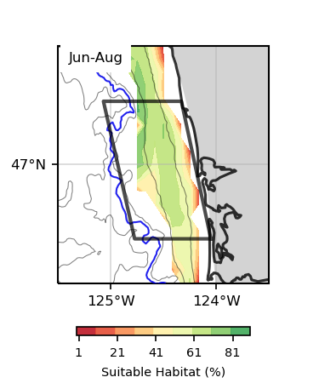
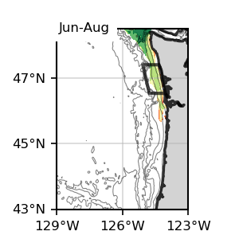
Bottom
1
Bottom
1
Pacific Halibut, Present

Slide 14
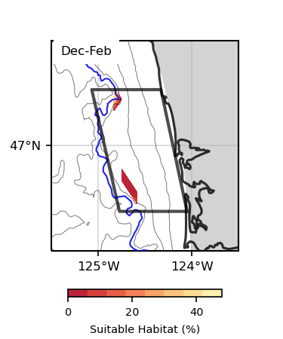
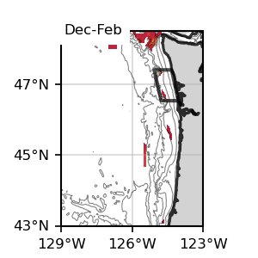
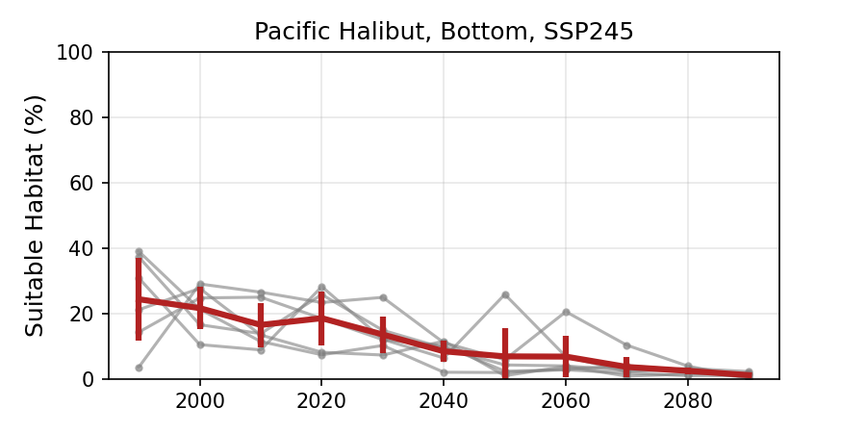
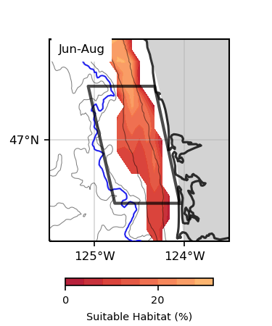
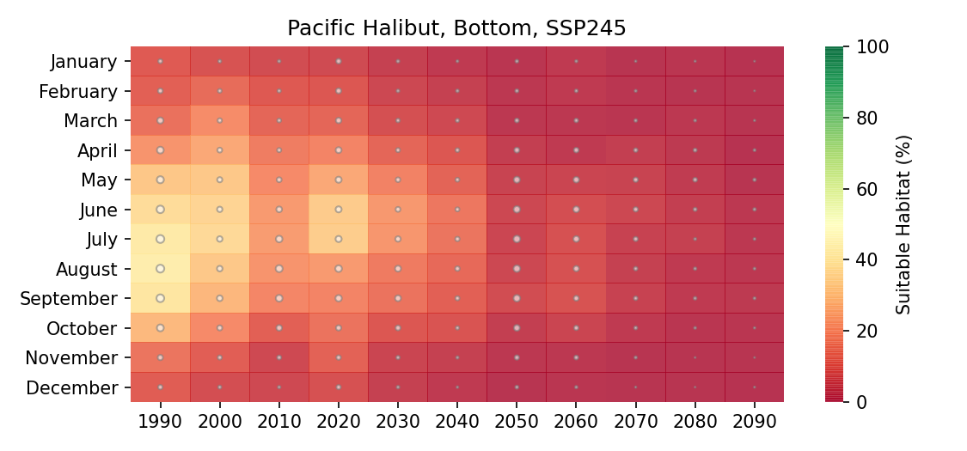
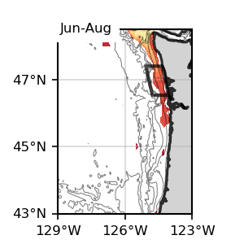
Bottom
1
Bottom
1

Slide 15
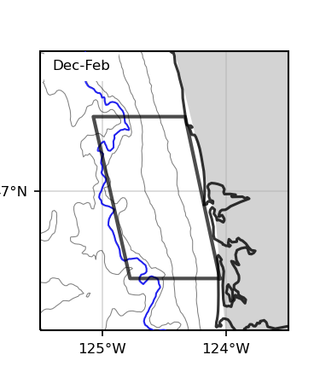
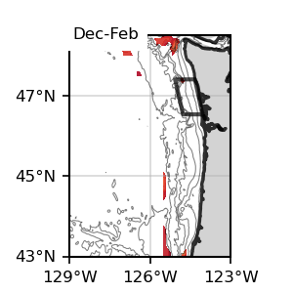
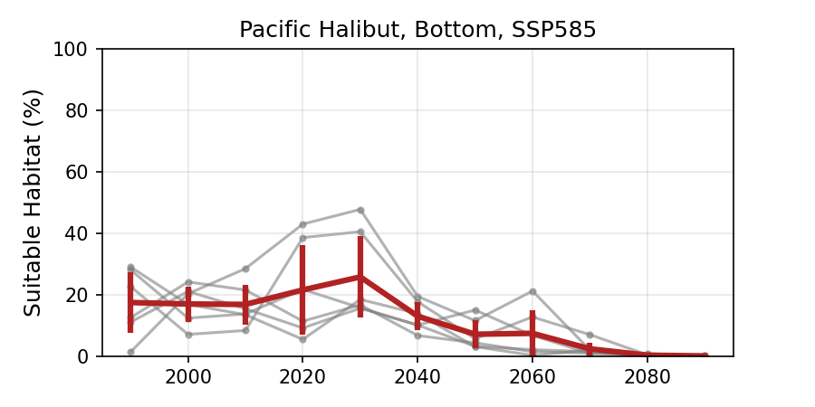
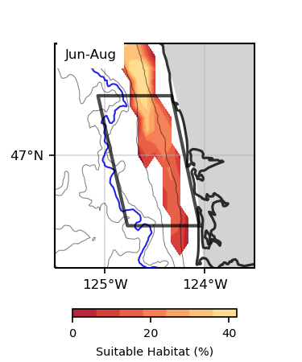
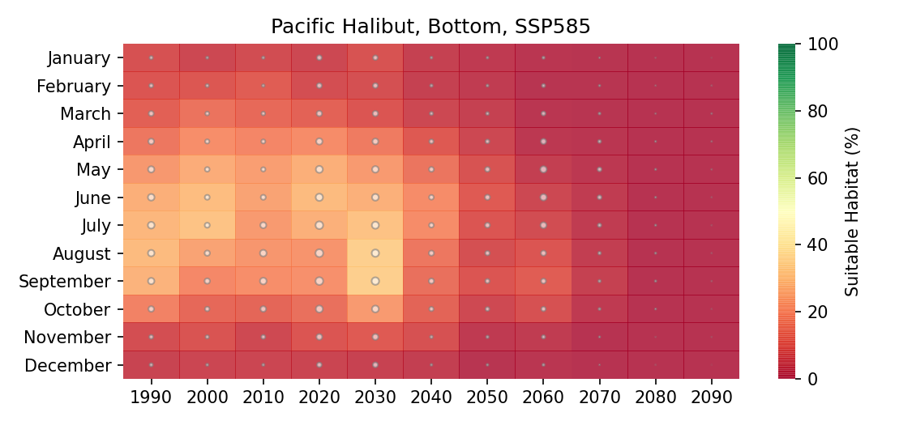
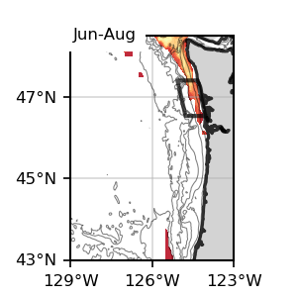
Bottom
1
Bottom
1

Slide 16
Chinook
Surface & Bottom

Slide 17




Surface
1
Surface
1
Chinook Salmon, Present

Slide 18





Surface
1
Surface
1

Slide 19




Surface
1
Surface
1

Slide 20




Bottom
1
Bottom
1
Chinook Salmon, Present

Slide 21






Bottom
1
Bottom
1

Slide 22






Bottom
1
Bottom
1

Slide 23
Coho
Surface

Slide 24




Surface
1
Surface
1
Coho Salmon, Present

Slide 25




Surface
1
Surface
1

Slide 26




Surface
1
Surface
1

Slide 27
Sockeye
Surface

Slide 28


Surface
1
Surface
1
Sockeye Salmon, Present

Slide 29




Surface
1
Surface
1

Slide 30



Surface
1
Surface
1

Slide 31
Razor Clams
Surface

Slide 32




Surface
1
Surface
1
Razor Clams, Present

Slide 33




Surface
1
Surface
1

Slide 34




Surface
1
Surface
1

Slide 35
Rockfish
Bottom

Slide 36




Bottom
1
Bottom
1
Rockfish spp., Present

Slide 37






Bottom
1
Bottom
1

Slide 38






Bottom
1
Bottom
1

Slide 39
Albacore
Surface

Slide 40



Surface
1
Surface
1
Albacore, Present

Slide 41






Surface
1
Surface
1

Slide 42






Surface
1
Surface
1

Slide 43
Hake
Surface & Bottom

Slide 44




Surface
1
Surface
1
Hake, Present

Slide 45






Surface
1
Surface
1

Slide 46






Surface
1
Surface
1

Slide 47




Bottom
1
Bottom
1
Hake, Present

Slide 48






Bottom
1
Bottom
1

Slide 49






Bottom
1
Bottom
1

Slide 50
Pink Shrimp
Bottom

Slide 51




Bottom
1
Bottom
1
Pink Shrimp, Present

Slide 52






Bottom
1
Bottom
1

Slide 53






Bottom
1
Bottom
1

Slide 54
California Halibut
Surface & Bottom

Slide 55


Surface
1
Surface
1
California Halibut, Present

Slide 56






Surface
1
Surface
1

Slide 57






Surface
1
Surface
1

Slide 58
Bottom
1
Bottom
1
California Halibut, Present

Slide 59






Bottom
1
Bottom
1

Slide 60




Bottom
1
Bottom
1

